Slide 1



TEAM NAME: WIDE JOY
Mentor–Mentee Connection Platform
Hackathon Proposal
IILM University
Team members: Kshitij mishra, Parivesh singh, Vanunjai, Dev shankar yadav

Slide 2

PROBLEM STATEMENT & WHY THIS PLATFORM IS NEEDED
Problems in Current Mentorship System
  Students struggle to access timely academic and career guidance
  Mentorship depends on informal personal networks
  No centralized way to:
  Report academic or personal issues
  Track mentorship requests
  Ensure follow-up and accountability
Key Gaps Identified
  No structured mentor discovery
  Lack of transparency in mentor assignment
  Poor scalability beyond small groups
  Missed announcements and delayed communication
Critical Need:
  A digital, role-based platform that democratizes mentorship and enables direct, secure communication between students and teachers.

Slide 3
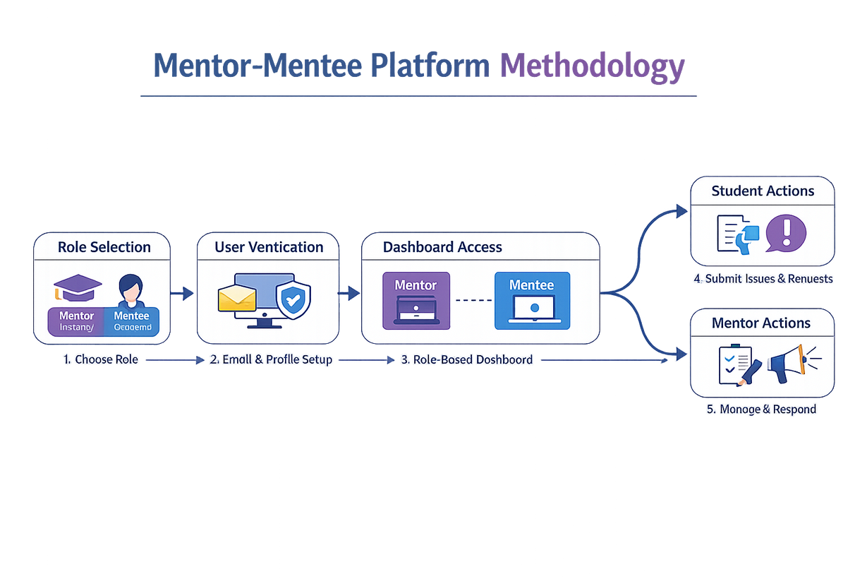
METHODOLOGY AND TECH STACK
  Frontend with HTML5, Tailwind CSS, and JavaScript
  UI and icon setup using Lucide Icons and Google Fonts
  Backend powered by Firebase Firestore
  email verification by phone.email hosting on GitHub or Firebase.

Slide 4
GAPS & LIMITATIONS
Identified Gaps
  No centralized platform for student–teacher communication
  Mentorship depends on informal personal networks
  Students lack visibility into available mentors and expertise
  No structured way to report academic or personal problems
  Absence of real-time status tracking for requests
Key Limitations
  Limited accessibility for students outside strong networks
  Poor transparency in mentor allocation and response process
  Lack of accountability and follow-up mechanisms
  Announcements and guidance often missed or delayed
  System not scalable for large universities

Slide 5
CONCLUSION FINAL PROPOSED SOLUTION
A centralized Mentor–Mentee Connection Platform with structured workflows for discovery, communication, and mentorship management.
Key Features
For Mentors (Faculty / Alumni):
  Manage assigned mentees via dashboard
  Review and respond to mentorship requests
  Broadcast official academic updates
  Track mentee progress and pending actions
For Students (Mentees):
  Profile creation with academic goals
  Discover mentors by expertise & availability
  Submit structured mentorship requests
  Track request status (Pending / Accepted / Rejected)
  Receive faculty announcements and resources

